Slide 1
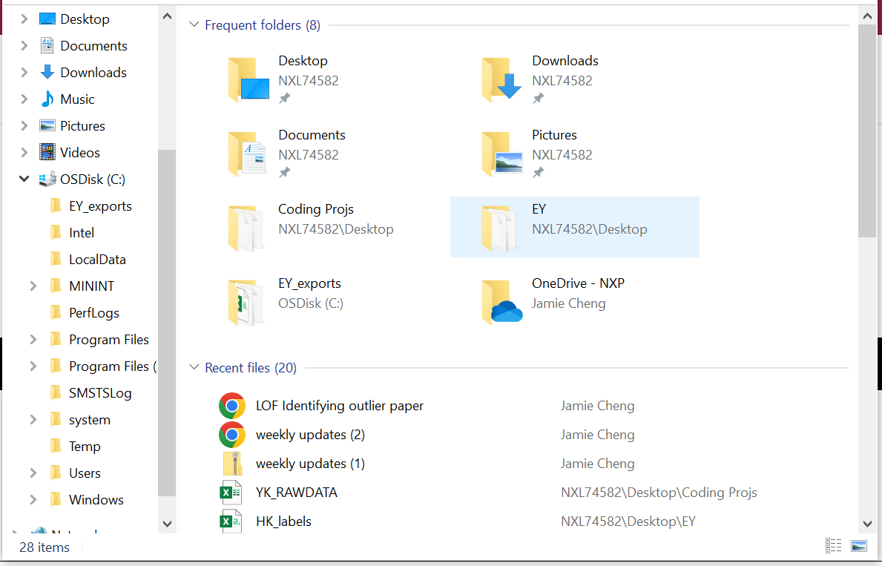
Create a directory under windows’ file explorer under the directory “OSDisk (C:)” (hard disc)

Slide 2
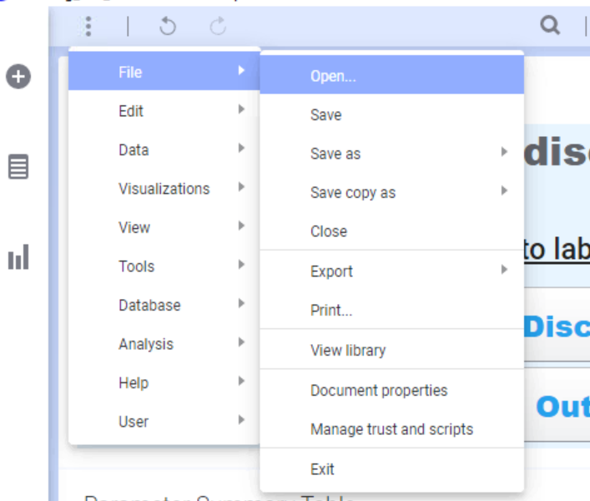
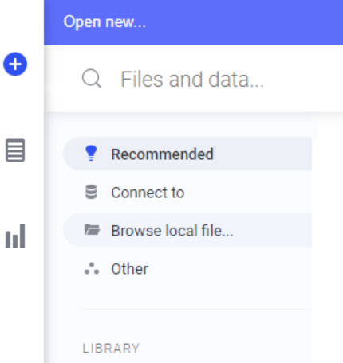
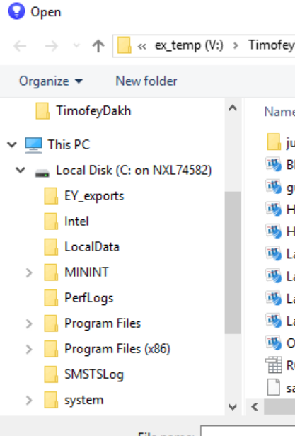

Ensure that the same folder is displayed in Exensio (it should)
Folder in which model is stored
Folder created in local disk (EY_exports) in this case
Copy and paste the trained model file from storage file indicated in jupyter notebook during saving to new folder created under local disk (EY_exports in this case)

Slide 3
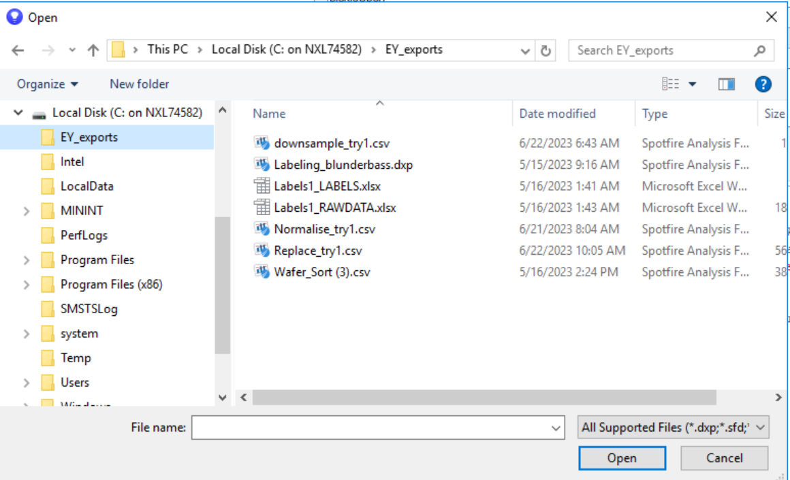
Note that trained model files are not visible in Exensio as they cannot be “opened” by exensio; but they do reside in them

Slide 4
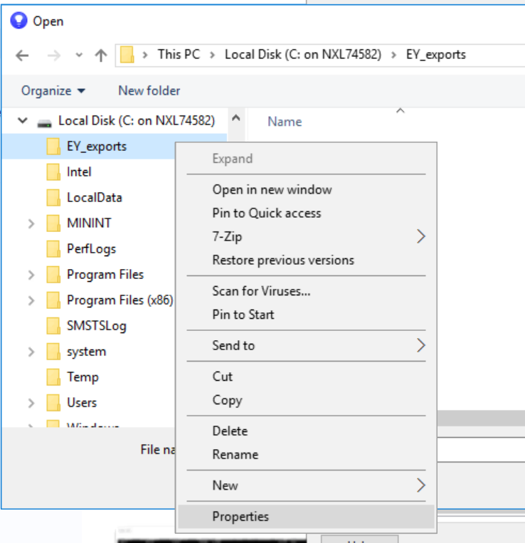
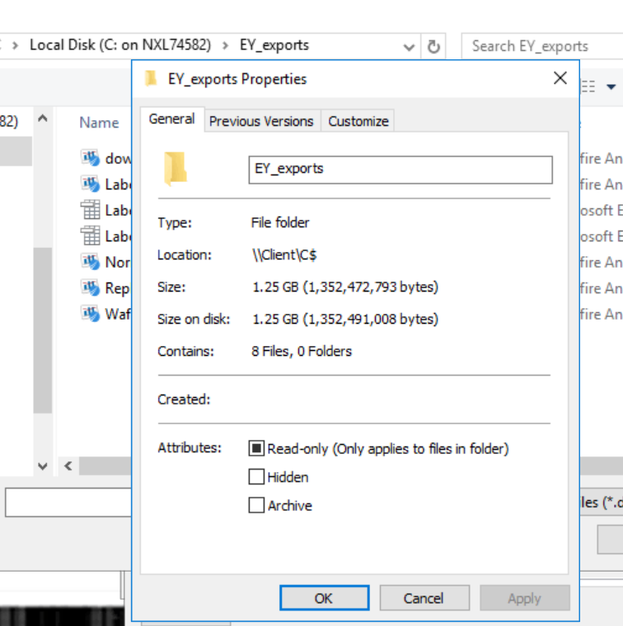
Left click new folder created under local disk and select properties
Pop-up should indicate the location – This is the path to the files in local disk

Slide 5
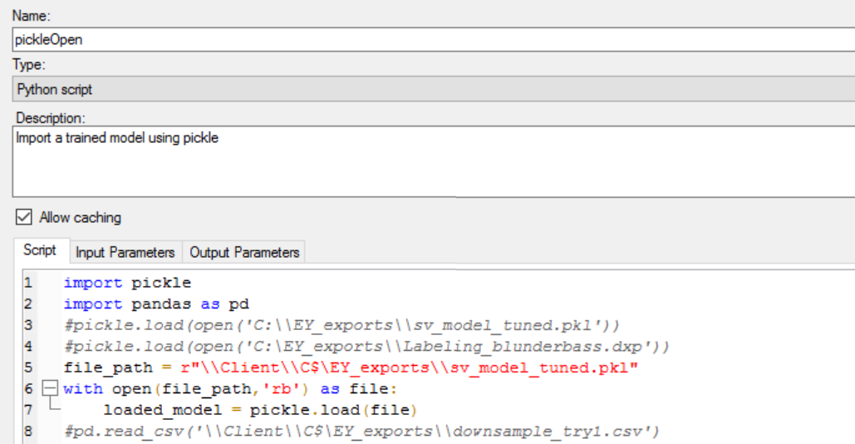
The complete file path to extract the model would be: file path from “properties” [refer to prev slide] + new folder created under local disk + trained model name

